Slide 1
Hashing
Reading: Chapter 10
Data Structures and Algorithms in Java

Slide 2
Introduction to Hashing through example
Main motivation of introducing hashing is to reduce running time of most used operations to O(1)
Illustration of hashing through a simple example
Assume n students
Recall that each student is issued an 8-digit number
How do we store the examination grades so that they can be accessed in Q(1) time?
Suppose Jane Doe has the number 20123456
We can’t create an array of size 10⁸ ≈ 1.5 × 2²⁶
but we could create an array of size 1000
How could you convert an 8-digit number into a 3-digit number?
First three digits might cause a problem: almost all students start with 201, 202, 203, 204, or 205
The last three digits, however, are essentially random
Therefore, Jane’s examination grade could be stored as following
grade[456] = 86;

Slide 3
Introduction to Hashing through example
Consequently, we have a function that maps a student onto a 3-digit number
We can store something in that location
Storing it, accessing it, and erasing it is O(1)
Process of mapping an object or a number onto an integer in a given range is called hashing
...
...
Problem: two or more students may map to the same number:
Alex Wang has ID 20183456 and scored 85
Alma Ahmed has ID 2019456 and scored 86
Such an event is termed a collision
multiple objects may hash to the same value
Hash tables use a hash function together with a mechanism for dealing with collisions
454
455
456 | 86
457
458
459
460
461
462
463 | 79
464
465
...
...

Slide 4
Hash Functions and Hash Tables
keys in a map are like “addresses” for the associated values.
One efficient way to implement a map in is to use a hash table.
Worst-case running time of map operations in an n-entry hash table is O(n).
But a hash table can usually perform these operations in O(1) expected time.
a hash table consists of two major components, a bucket array and a hash function.

Slide 5
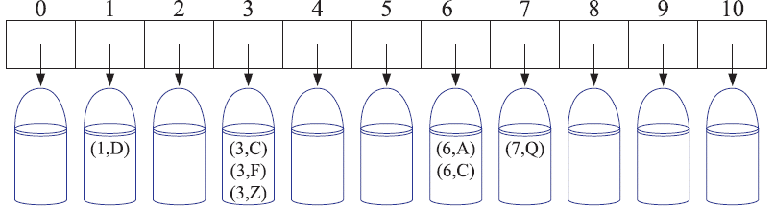
Bucket Array
Bucket array for a hash table is an array A of size N,
each cell of A is thought of as a “bucket”
that is, a collection of key-value pairs
N defines the capacity of the array.
If the keys are unique integers well distributed in the range [0,N −1], then each bucket holds at most one entry.
An entry e with key k is simply inserted into the bucket A[k].
searches, insertions, and removals in the bucket array take O(1) time
This sounds like a great achievement, but it has two drawbacks
bucket array of size 11 for the entries (1,D), (3,C), (3,F), (3,Z), (6,A), (6,C), and (7,Q).

Slide 6
Hash Functions and Hash Tables
1st drawback: the space used is proportional to N.
Thus, if N is much larger than the number of entries n actually present in the map, we have a waste of space.
2nd drawback: keys are required to be integers in the range [0,N−1],
This is often not the case.
Therefore, bucket array is used in conjunction with a “good” mapping from the keys to the integers in the range [0,N −1].
bucket array of size 11 for the entries (1,D), (3,C), (3,F), (3,Z), (6,A), (6,C), and (7,Q).

Slide 7
Hash Functions and Hash Tables
A hash function h maps keys of a given type to integers in a fixed interval [0, N - 1] where N is the size of the bucket array
Example1: h(k) = k mod N is a hash function for integer keys
The integer h(k) is called the hash value of key k and can be used as an index in bucket array, A, instead of the key k
That is, entry (k,v) is stored in the bucket A[h(k)].
Collision occurs when two or more keys with the same hash value might be mapped to the same bucket in A.
0
∅
1
025-612-0001
Example 2: h(k) = last four digits of k
We design a hash table for a map storing entries as (SSN, Name), where SSN (social security number) is a nine-digit positive integer
Our hash table uses an array of size N = 10,000
2
981-101-0002
3
∅
4
451-229-0004
…
9997
∅
9998
200-751-9998
9999
∅
Notes:
Clearly, if each bucket of A can store only a single entry, then we cannot associate more than one entry with a single bucket, which is a problem in the case of collisions.

Slide 8
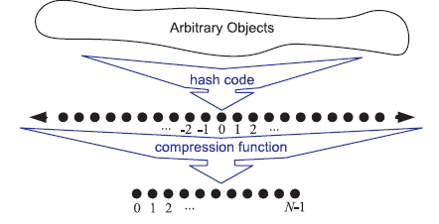
Hash Functions
Evaluation of a hash function, h(k), as consisting of two actions
hash code : mapping the key k to an integer (h₁: keys → integers)
compression function: mapping the hash code to an integer within the range of indices ([0,N −1]) of a bucket array (h₂: integers → [0, N - 1])
The hash code is applied first, and the compression function is applied next on the result, i.e., h(x) = h₂(h₁(x))
The goal of the hash function is to “disperse” the keys in an apparently random way

Slide 9
Hash Codes (h₁: keys → integers)
Hash codes assigned to our keys to avoid collisions as much as possible
If hash codes cause collisions, compression function cannot avoid them.
Also h(k) = h(k’) whenever k = k’.
Some example functions for assigning hash codes to objects:
Converting to an Integer :
For any data type X (e.g., byte, short, int and float in C++) that has a length less than or equal to the number of bits as our integer hash codes:
simply take an integer interpretation of its bits as a hash code for X
One possible hash code for a long object is to simply cast it down to an integer and then apply the integer hash code.
Problem: ignores half of the information present in the original value
Collision : when many keys differ only in these bits which were ignored.

Slide 10
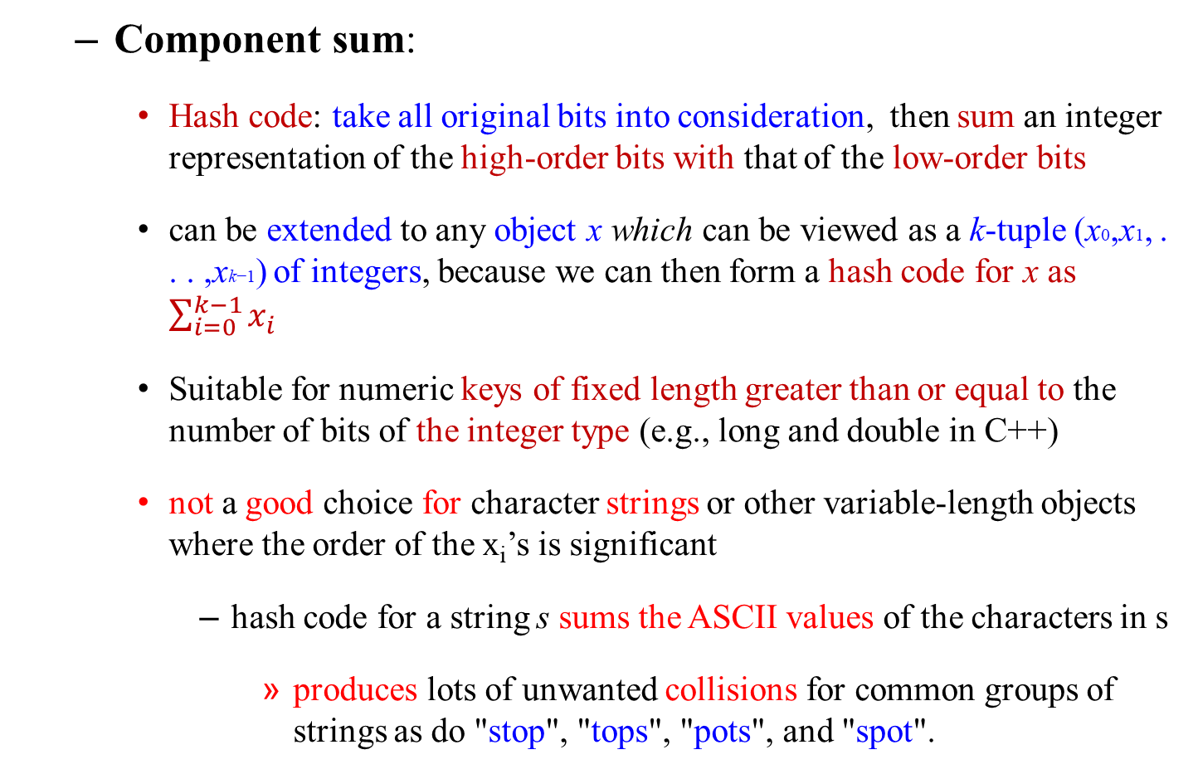
Hash Codes (h₁: keys → integers)
Component sum:
Hash code: take all original bits into consideration, then sum an integer representation of the high-order bits with that of the low-order bits
can be extended to any object x which can be viewed as a k-tuple (x0,x1, . . . ,xk−1) of integers, because we can then form a hash code for x as $\sum_{i=0}^{k−1}{x_{i}}$
Suitable for numeric keys of fixed length greater than or equal to the number of bits of the integer type (e.g., long and double in C++)
not a good choice for character strings or other variable-length objects where the order of the x_{i}’s is significant
hash code for a string s sums the ASCII values of the characters in s
produces lots of unwanted collisions for common groups of strings as do "stop", "tops", "pots", and "spot".

Slide 11
Hash Codes (cont.)
Polynomial accumulation:
Object x can be viewed as a k-tuple (x0,x1, . . . ,xk−1)
When order of x_{i}’s is significant then a better hash code takes into consideration the positions of the x_{i}’s. An alternative hash code chooses a nonzero constant, a !=1, and uses x₀a^{k−1} + x₁a^{k−2} + ··· + x_{k−2}a + x_{k−1} as a hash code value.
this is simply a polynomial in a with (x0, x1, . . . , xk−1) as its coefficients
By Horner’s rule can be rewritten as
x_{k−1}+a(x_{k−2} +a(x_{k−3} +···+a(x₂+a(x₁ +ax₀)) ···)).
p(a) = x₀a^{k−1} + x₁a^{k−2} + x₂a^{k−3} + ··· + x_{k−3}a² + x_{k−2}a + x_{k−1}
p(a) = (x₀a^{k−2} + x₁a^{k−3} + x₂a^{k−4} + ··· + x_{k−3}a + x_{k−2})a + x_{k−1}
p(a) = ((x₀a^{k−3} + x₁a^{k−4} + x₂a^{k−5} + ··· + x_{k−3})a + x_{k−2})a + x_{k−1}
p(a) = ((…((x₀a + x₁)a + x₂)a^{k−5} + ··· + x_{k−3})a + x_{k−2})a + x_{k−1}
successively computed, each from the previous one: p₀(a) = x₀ and p_{i} (a) = x_{i} + ap_{i−1}(a)
Experimental result: the choice a = 33 gives at most 6 collisions on a set of 50,000 English words

Slide 12
Hash Codes (cont.)
Cyclic Shift Hash Codes
variant of the polynomial hash code that replaces multiplication with a cyclic shift of a partial sum by a certain number of bits.
To achieve a 5-bit cyclic shift we form the “bitwise or” of a 5-bit left shift and a 27-bit right shift. As before, we use an unsigned integer so that right shifts fill with zeros.
Static int hashCode(String s) {
int h = 0;
for (int i = 0; i < s.length(); i++) {
h = (h << 5) | (h >>> 27); // 5-bit cyclic shift
h += (int) s.charAt(i) ; //s add in next character
}
return h;
}
For example, a 5-bit cyclic shift of the 32-bit value 00111101100101101010100010101000 is achieved by taking the leftmost five bits and placing those on the rightmost side of the representation,
resulting in 10110010110101010001010100000111

Slide 13
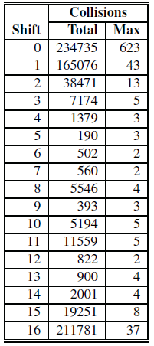
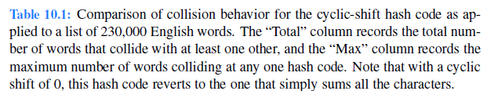
Hash Codes (cont.)
Cyclic Shift Hash Codes-Experimental Results

Slide 14
Compression Functions
Division:
h(k) = |k| mod N,
The size N of bucket array (hash table) is usually chosen to be a prime
If N=100, hash keys {200, 205, 210, 215, 220, . . . , 600}
each hash code collides with three others. But if this same set of keys is similarly hashed to a bucket array of
If N= 101, then there are no collisions.
If a hash function is chosen well, it should ensure that the probability of two different keys getting hashed to the same bucket is 1/N.
Choosing N to be a prime number is not always enough, because if there is a repeated pattern of key values of the form iN + j for several different i’s, then there are still collisions.

Slide 15
Compression Functions
Multiply, Add and Divide (MAD):
helps eliminate repeated patterns
h(k) = |ak+b| mod N
a and b are nonnegative integers such that a mod N ≠ 0
N is a prime number
Otherwise, every integer would map to the same value b

Slide 16
Collision Handling- Separate chaining
Collisions occur when different elements are mapped to same cell
Separate Chaining let each each bucket A[i] to be an empty list-based map, M_{i}
Algorithm get(k):
return A[h(k)].get(k)
Algorithm put(k,v):
t = A[h(k)].put(k,v)
if t = null then {k is a new key}
n = n + 1
return t
Algorithm remove(k):
t = A[h(k)].remove(k)
if t ≠ null then {k was found}
n = n - 1
return t
put(k,v) scans this list looking for an entry with key equal to k; if it finds one, it replaces its value with v, otherwise, it puts (k,v) at the end of this list

Slide 17
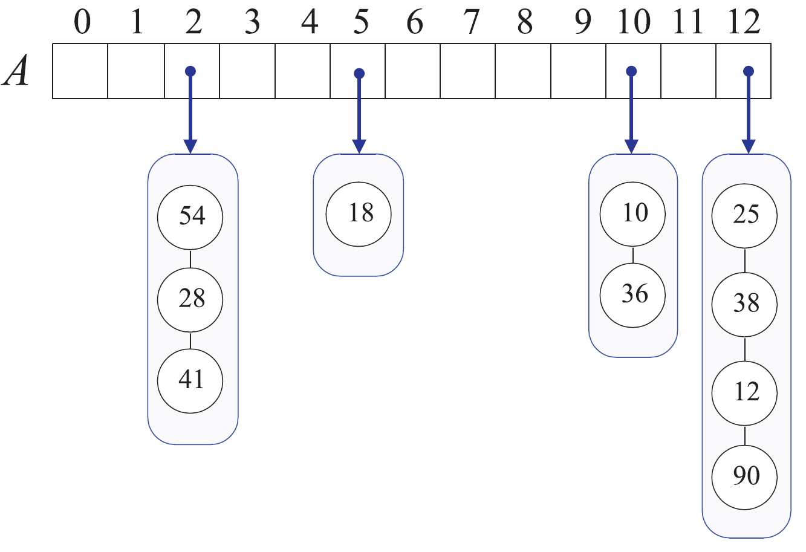
Collision Handling- Separate chaining
A hash table of size 13, storing 10 entries with integer keys
Collisions resolved by separate chaining
compression function: h(k)=k mod 13.
Assume good hash function indexing n entries of our map in a bucket array of capacity N, we expect each bucket to be of size n/N.
This value, called the load factor α of the hash table should be bounded by a small constant, preferably below 1.
running time of operations find, put, and erase in a map implemented with a hash table is O(⌈n/N⌉).
Thus, we can implement these operations to run in O(1) expected time provided n is O(N) and α is constant.

Slide 18
Collision Handling- Open addressing
Separate-chaining is simple to implement but it requires the use of an auxiliary data structure.
We can use the alternative approach of always storing each entry directly in a bucket, at most one entry per bucket.
Open addressing: the colliding item is placed in a different cell of the table

Slide 19
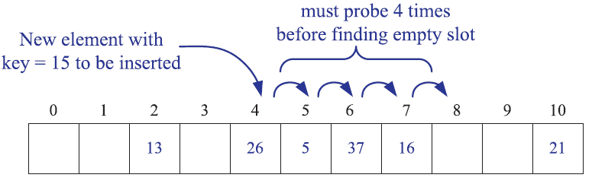
Collision Handling- Open addressing Linear Probing
Linear probing: handles collisions by placing the colliding item in the next (circularly) available table bucket
Each table cell inspected is referred to as a “probe”
Colliding items lump together, causing future collisions to cause a longer sequence of probes
An insertion into a hash table using linear probing to resolve collisions.
Here we use the compression function h(k) = k mod 11.

Slide 20
Search with Linear Probing
Consider a hash table A that uses linear probing
get(k)
We start at cell h(k)
We probe consecutive locations until one of the following occurs
An item with key k is found, or
An empty cell is found, or
N cells have been unsuccessfully probed
Algorithm get(k)
i ← h(k)
p ← 0
repeat
c ← A[i]
if c = ∅
return null
else if c.getKey () = k
return c.getValue()
else
i ← (i + 1) mod N
p ← p + 1
until p = N
return null

Slide 21
Updates with Linear Probing
To handle insertions and deletions, we introduce a special object, called AVAILABLE, which replaces deleted elements
remove(k)
We search for an entry with key k
If such an entry (k, o) is found, we replace it with the special item AVAILABLE and we return element o
Else, we return null
put(k, o)
We throw an exception if the table is full
We start at cell h(k)
We probe consecutive cells until one of the following occurs
A cell i is found that is either empty or stores AVAILABLE, or
N cells have been unsuccessfully probed
We store (k, o) in cell i

Slide 22
Limitations Linear Probing
Even with the use of the available marker object, linear probing suffers from an additional disadvantage.
It tends to cluster the entries of the map into contiguous runs, which may even overlap.
Such contiguous runs of occupied hash cells causes searches to slow down considerably.

Slide 23
Collision Handling- Open addressing quadratic probing
Quadratic Probing is an attempt to keep clusters from forming.
The idea is to probe more widely separated cells when looking for an empty entry, instead of probing the adjacent cells to the primary hash position
index = h(i) = (i+ f (j)) mod N) mod N;
probe bucket A[index], for j = 0,1,2, . . ., where f(j)=j², until finding an empty bucket.
In linear probing, if the primary hash index is i, subsequent probes go to i+1, i+2, i+3, and so on
In Quadratic Probing, successive probes happen at i, i + 1, i + 4, i + 9, and so on.
quadratic-probing complicates the removal operation, but it does avoid the kinds of clustering patterns that occur with linear probing.
Nevertheless, it creates its own kind of clustering, called secondary clustering, where the set of filled array cells “bounces” around the array in a fixed pattern.

Slide 24
Double Hashing
Double hashing uses a secondary hash function d(k) and handles collisions by placing an item in the first available cell of the series (i + jd(k)) mod N for j = 0, 1, … , N - 1
The secondary hash function d(k) cannot have zero values
The table size N must be a prime to allow probing of all the cells
Common choice of compression function for the secondary hash function:
d₂(k) = q - k mod q
where
q < N
q is a prime
The possible values for d₂(k) are 1, 2, … , q

Slide 25
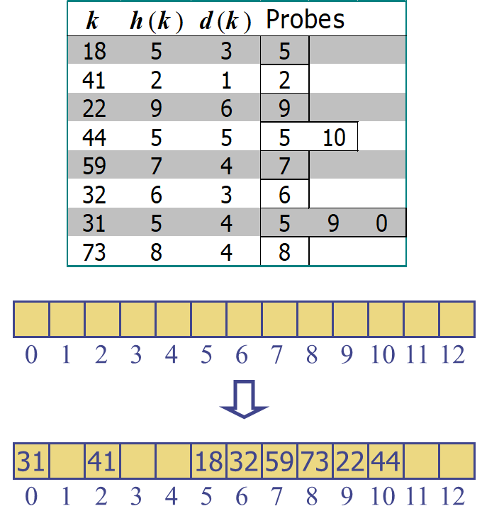
Example of Double Hashing
Consider a hash table storing integer keys that handles collision with double hashing
N = 13
h(k) = k mod 13
d(k) = 7 - k mod 7
Insert keys 18, 41, 22, 44, 59, 32, 31, 73, in this order

Slide 26
Performance
In the worst case, searches, insertions and removals on a hash table take O(n) time
The worst case occurs when all the keys inserted into the map collide
The expected running time of all the dictionary ADT operations in a hash table is O(1)
In practice, hashing is very fast provided the load factor is not close to 100%

